Slide 1
MCA Major Project Mid Term Evaluation
Ticket Analysis and Support
Under the guidance of
Dr. Kuntal Gaur
Department of Computer Applications
Faculty of Science, Technology and Architecture
Manipal University Jaipur
By
AWANI VINIT SATHE
23FS20MCA00007
2023-25

Slide 2
OUTLINE
Introduction
Motivation
Process Model
Software Requirement Specification (SRS)
Data Flow Diagram (DFD)
Output
Conclusion
Future Scope

Slide 3
INTRODUCTION
The 'Ticket Analysis and Support' project aims to streamline and optimize customer support ticket management by leveraging state-of-the-art technologies such as FastAPI, Meta LLaMA, MySQL, and Gmail SMTP. By automating the ticket classification process using AI, this system improves efficiency, reduces response time, and enhances accuracy in handling support requests.
The project employs a modular architecture that integrates Natural Language Processing (NLP) for ticket classification, a relational database for data persistence, and automated notification systems. This provides a comprehensive solution that is scalable, accurate, and robust.
Why you should choose us?
The system offers an innovative approach by leveraging AI for automated ticket analysis, making it a reliable and efficient solution to streamline customer support processes. With features such as accurate ticket categorization, prompt email notifications, and robust backend management, this solution is designed to significantly enhance support efficiency and improve user satisfaction.

Slide 4
MOTIVATION
The motivation for developing the "Ticket Analysis and Support" system arises from the need to address limitations present in conventional ticket management systems. Existing methods often involve:
High Operational Costs: Due to the requirement of extensive manual intervention for ticket categorization and routing.
Inaccurate Classification: Manual processes are prone to errors, leading to inefficient ticket resolution.
Delayed Responses: Due to inefficient ticket routing and lack of automation, resulting in decreased user satisfaction.
Scalability Challenges: Difficulty in handling a growing volume of tickets without compromising performance.
The primary objectives driving the development of this project include reducing operational costs, enhancing classification accuracy, improving user experience through timely responses, and building a scalable infrastructure that can accommodate high ticket volumes with minimal performance degradation.

Slide 5
PROCESS MODEL
The "Ticket Analysis and Support" system follows the Agile development model to ensure continuous progress, iterative refinement, and prompt integration of feedback. The project’s lifecycle is divided into the following phases:
Requirement Gathering: Understanding the functional and non-functional requirements from stakeholders.
System Design: Creating architectural diagrams, Data Flow Diagrams (DFDs), and database schemas to ensure clarity and coherence in design.
Implementation: Developing the backend using FastAPI, integrating MySQL for data management, deploying Meta LLaMA for AI-driven classification, and setting up Gmail SMTP for automated email notifications.
Testing & Evaluation: Conducting comprehensive testing, including unit, integration, and user acceptance testing to validate system robustness.
Deployment & Monitoring: Deploying the system on a server environment and monitoring its performance and scalability.

Slide 6
SOFTWARE REQUIREMENT SPECIFICATIONS (SRS)
Software Requirements
Programming Language: Python (FastAPI)
Database Management System: MySQL
Artificial Intelligence Model: Meta LLaMA
Email Service Protocol: Gmail SMTP
Integrated Development Environment: Visual Studio Code
Libraries & Dependencies: pydantic, mysql-connector-python, openai, smtplib, email.message
Functional Requirements
Automated ticket classification using Meta LLaMA.
Persistent data storage and retrieval via MySQL.
Automated notification system through Gmail SMTP.
API endpoints for ticket submission and management using FastAPI.
Non-Functional Requirements
High scalability to accommodate increasing ticket volumes.
Enhanced security through encryption and authentication mechanisms.
Performance optimization to ensure efficient ticket processing.

Slide 7
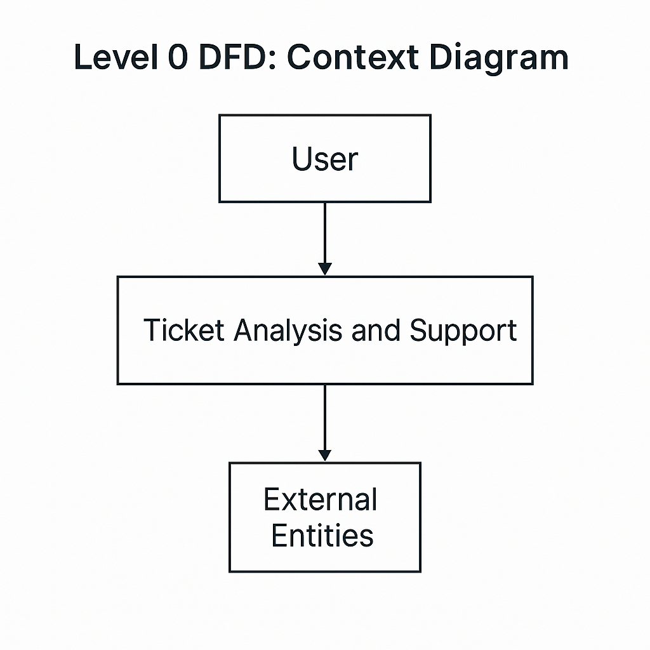
DATA FLOW DIAGRAM (DFD)
Level 0 DFD: Context Diagram –
User interaction with FastAPI backend to submit tickets.

Slide 8
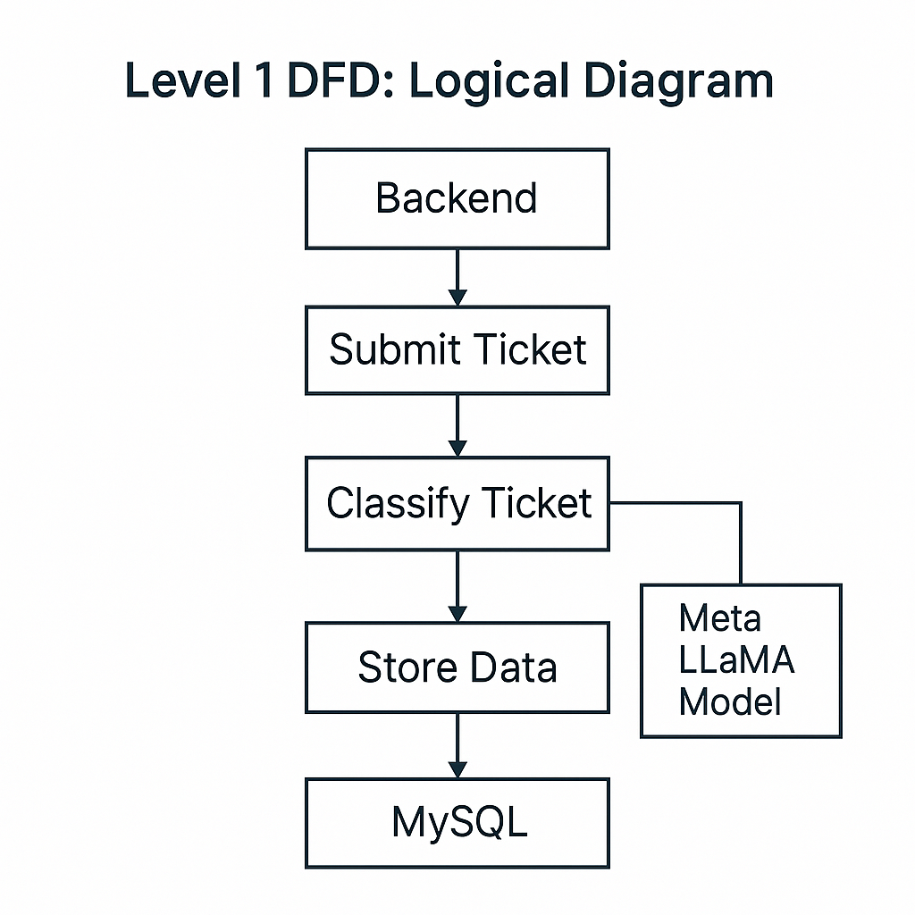
Level 1 DFD: Logical Diagram –
Backend processes the ticket, classifies it using Meta LLaMA model, and stores data in MySQL.

Slide 9
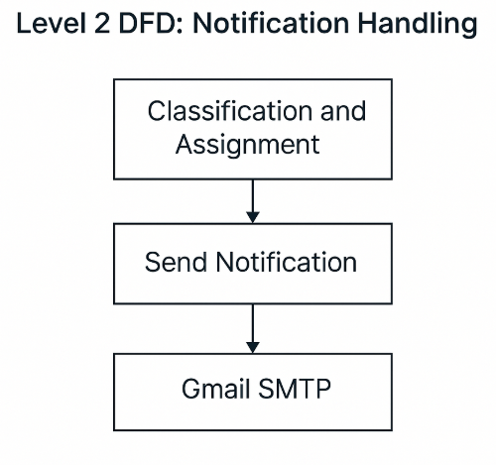
Level 2 DFD: Notification Handling -
Notifications are sent via Gmail SMTP based on classification and assignment.

Slide 10
OUTPUT
The "Ticket Analysis and Support" system presents a comprehensive solution for efficiently managing customer support tickets. It begins with users submitting tickets through an API-based interface powered by FastAPI. The ticket details, including user queries and relevant metadata, are then processed by the system.
The Meta LLaMA model performs intelligent classification of tickets, sorting them into predefined categories such as Technical Support, Account Management, Billing, etc. This automated classification ensures accurate routing of tickets to the appropriate departments or agents.
Following classification, the ticket data is stored in a MySQL database, designed for high-performance retrieval and secure data handling. The use of a relational database facilitates efficient management and analysis of all incoming tickets.
Automated notifications are dispatched through Gmail SMTP, ensuring prompt acknowledgment of tickets and providing relevant stakeholders with real-time updates. The system architecture, designed using FastAPI, offers a modular and scalable framework suitable for future enhancements and integration of additional features.

Slide 11
CONCLUSION
The 'Ticket Analysis and Support' system offers a robust, scalable, and efficient approach to managing customer support tickets. By integrating advanced AI models for classification and automated notification systems, it significantly improves response times, reduces operational costs, and enhances accuracy in ticket handling.
Future enhancements may include improved AI models, real-time monitoring dashboards, enhanced data security, and multi-language support.

Slide 12
FUTURE SCOPE
1. Integration of advanced AI models for higher accuracy and robustness.
2. Implementation of real-time analytics and monitoring dashboards.
3. Enhanced security protocols for data protection and privacy.
4. Multi-language support to improve accessibility and usability.
5. Development of a user-friendly frontend interface for seamless interaction.

